Slide 1
Project Capstone
File created on: 27-03-2021 22:43:50

Slide 2
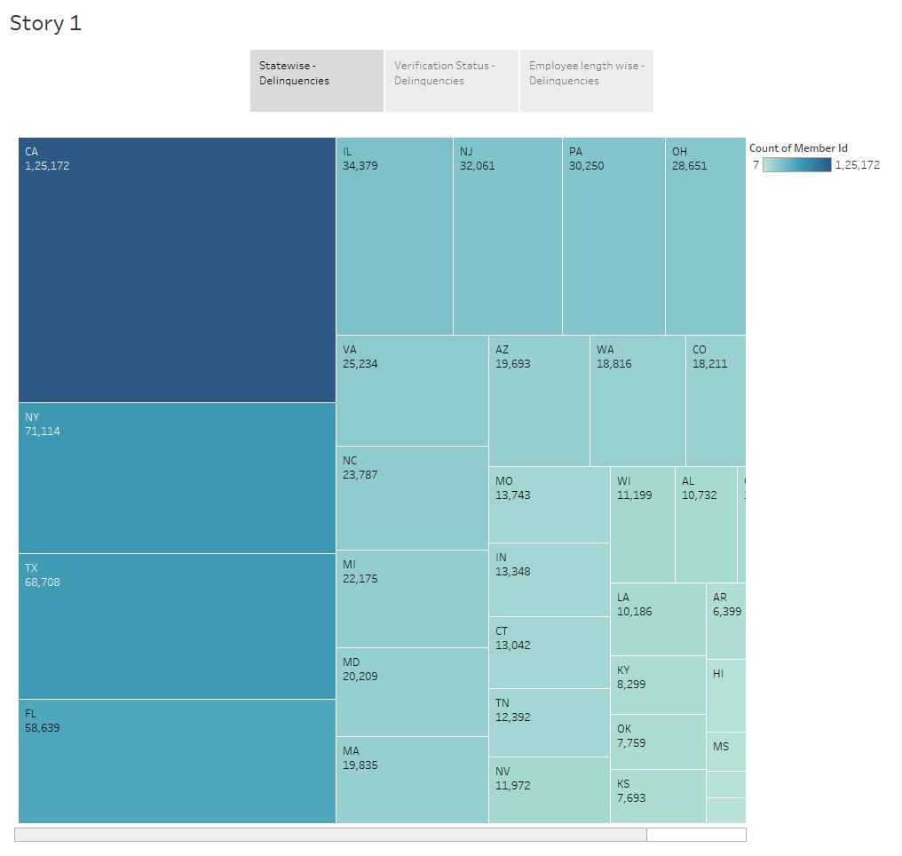

Slide 3
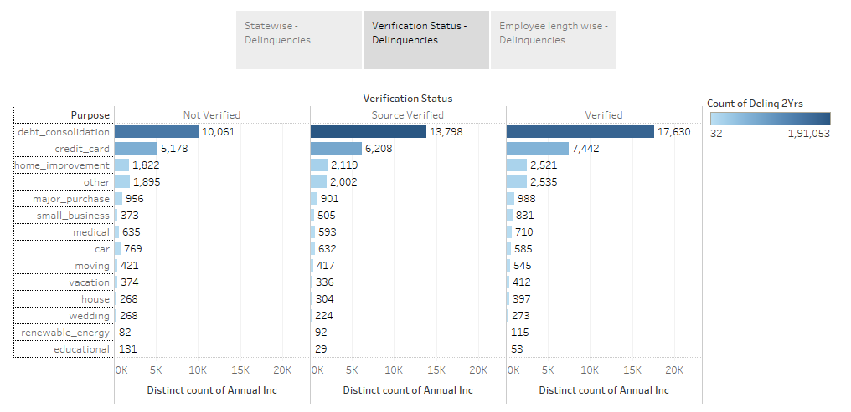

Slide 4
